Slide 1
Youtube Songs
Data Analysis
Our Music Playlists
Search
Home
Library

Slide 2
Contents of this report
1. | Executive Summary
2. | Problem Statement
3. | Data Description
4. | Project Obejctives
5. | Tableau Dashboards
6. | Recommendatations For Content Creators And Stakeholders
Project Owner: Neha Chaudhari

Slide 3
Executive Summary
This report provides a comprehensive analysis of YouTube songs data to uncover trends, preferences, and patterns. The analysis was performed using Tableau, focusing on key areas such as channel and content analysis, temporal trends, and user engagement insights. The findings aim to aid content creators and stakeholders in optimizing their YouTube song content.

Slide 4
Problem Statement
This internship project aims to conduct a comprehensive analysis of YouTube songs data using Tableau. The dataset contains key attributes such as video ID, channel title, title, description, tags, published date, view count, like count, favorite count, comment count, video duration, video definition, and caption details. The goal is to utilize Tableau to create insightful visualizations and reports that provide a deeper understanding of YouTube songs' performance, popularity, and user engagement. The analysis aims to uncover trends, preferences, and patterns in the data to aid content creators and stakeholders in optimizing their YouTube song content.

Slide 5
Data Description
1. video_id: Unique identifier for each YouTube video.
2. channelTitle: Title of the YouTube channel publishing the song.
3. title: Title of the YouTube song video.
4. description: Description provided for the YouTube song video.
5. tags: Tags associated with the YouTube song video.
6. publishedAt: Date and time when the YouTube song video was published.
7. viewCount: Number of views received by the YouTube song video.
8. likeCount: Number of likes received by the YouTube song video.
9. favoriteCount: Number of times the YouTube song video has been marked as a favorite.
10. commentCount: Number of comments posted on the YouTube song video.
11. duration: Duration of the YouTube song video.
12. definition: Video definition or quality (e.g., HD, SD).
13. caption: Availability of captions for the YouTube song video.

Slide 6
Project Objectives
01
02
03
04
Data Cleaning and Preparation
Exploratory Data Analysis (EDA)
3:15min
3:15min
Content and Channel Analysis
User Engagement Insights & Trends
3:15min
3:15min

Slide 7
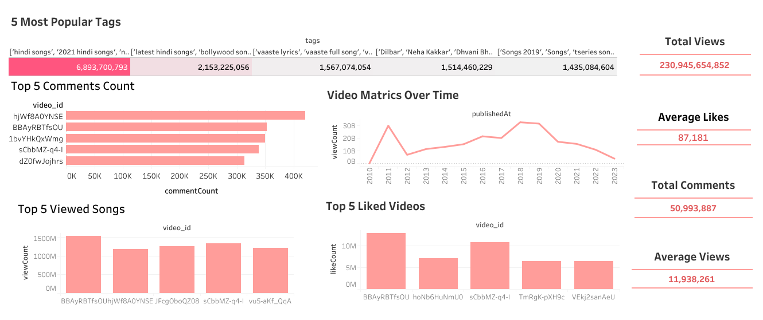

Slide 8
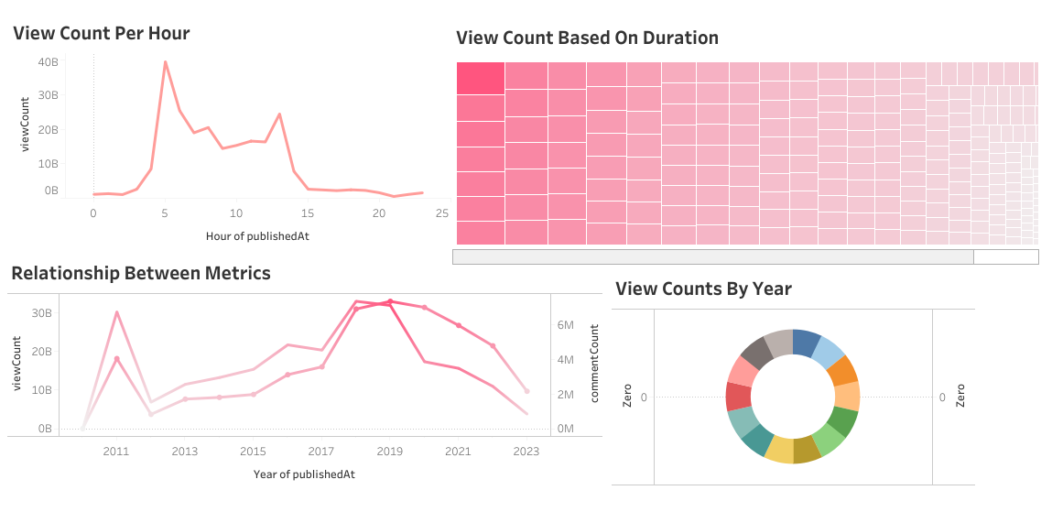

Slide 9
Recommendations
1. Optimize Publishing Times: Publish videos during peak hours (6 PM to 9 PM) to maximize engagement.
2. Utilize Popular Tags: Use frequently searched tags like "Pop", "Official Music Video" to increase visibility and engagement.
3. Enhance Video Quality: Produce HD content with captions to boost likes and comments.
4. Focus on High-Engagement Channels: Collaborate with top-performing channels to reach a wider audience.

Slide 10
Conclusion
The analysis provides valuable insights into the performance, popularity, and user engagement of YouTube song videos. By leveraging these findings, content creators and stakeholders can make informed decisions to enhance their content strategy and maximize engagement.

Slide 11
Thank You !

